Slide 1

Whatsapp

Slide 2

SOFTWARE DESIGN
&
ARCHITECTURE
Of WhatsApp

Slide 3
1.general
2.erlang
3.xmpp
4.working(actor model,implementation)
Quora link + another link
5.group messages
6 verifying keys
Give def of chain ley etc.
6.encryption
7.conclusion

Slide 4
What is Whatsapp and how does it work ??!!
→ the first part is known to everyone so lets jump to the second.
→ Lets see what whatsapp consists of:
> Backend:
→ Erlang
→ FreeBSD
→ Yaws, lighttpd
→ PHP
→ Custom patches to BEAM (BEAM is like Java’s JVM, but for Erlang)
→ Custom XMPP
→ Hosting may be in Softlayer
> Frontend
→ Seven client platforms: iPhone, Android, Blackberry, Nokia Symbian S60, Nokia S40, Windows Phone, ?
→ SQLite

Slide 5

We know that programming language is of vital importance for a software in both ease of understanding and efficiency of working.
So what language is used for programming a billion dollar software such as Whatsapp:
It is a programming language called as Erlang:
If you didn’t know many other famous softwares such as
→ facebook
→ amazon
Etc also use erlang as their programming language

Slide 6
Why does Whatsapp prefer using Erlang over
other languages:
Erlang is a general-purpose, concurrent, garbage-collected programming language and runtime system. It supports distributed, fault-tolerant, soft real-time, highly available, non-stop applications. It supports hot swapping so code can be changed without stopping a system.
1. If the application handles very large number of concurrent activities: Whatsapp handle multiple activities concurrently like fetching and sending multiple messages to multiple users from/to at the same time.
2.If the application need scale with the number of machines on the network: Whatsapp have a around 900 million active users per month and it handles around 10 billion messages each day. That is a very high concurrency rate on the whatsapp server, and the server handles them seamlessly without ever crashing.
3. If the application need to stay in continuous operation for many years: Often applications servers are rebooted (also known as downtime) because of system or code upgradation, this can be prevented in Erlang because it supports hot-swapping which means you can upgrade your server application code without having any downtime.

Slide 7

Moving on from the programming language lets see about whatsapp architecture which made it one of the most preferred chat software:
The Software Protocol used by Whatsapp is called as XMPP
Which means Extensible Messaging and Presence Protocol.
→ Whatsapp uses a customized version of XMPP.
→ XMPP is a communications protocol for message – oriented middleware based on XML.
→ XMLL is a simple protocol that occurs over TCP sockets using XML language.

Slide 8
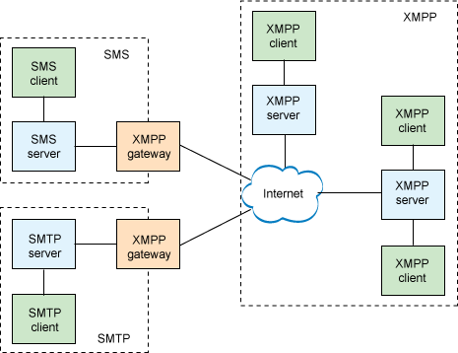
This is how a XMPP Architecture works:

Slide 9
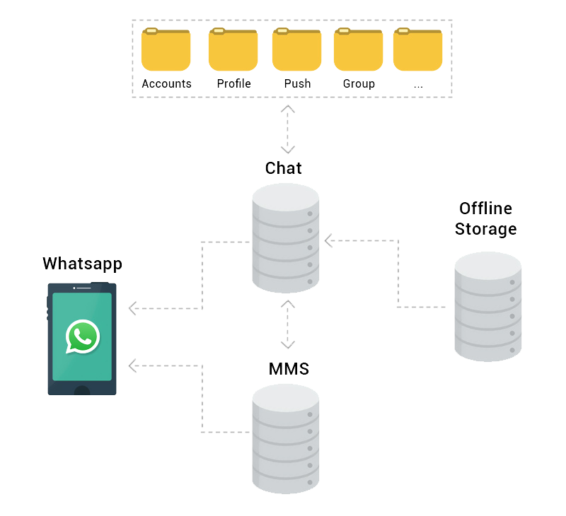
Implementation of Whatsapp:
A simple implementation of WhatsApp could be: Each user/device is represented as an actor. This actor is responsible for handling the inbox of the user, how it gets serialized to disk, the messages that the user sends and the messages that the user receives.
Whatsapp is an application that is able to handle approximately 50 billion message transfers a day. The main reason behind its popularity is the data processing of the message queue length which is associated with a node is
being monitored.
WhatsApp utilizes XMPP protocol where the queue is maintained and the messages will wait till the queue message is received by the receiver node. The Notifications is received by the sender when the message is received by the receiver. After the delivery of the messages , the messages are immediately removed
from the server.

Slide 10
Lets see how a conversation works in Whatsapp:
Step1: User A sends a message user B
Step2: If user A is not connected to WhatsApp server the message stays inlocal sqlite DB of WhatsApp application
Step3:As soon as it connects to internet, connection establishes and messages will be sent.
Step4:If server successfully receives that messages it ACK
Step5:Else no ack received so, client will keep retrying to send the same message
Step6: once server receives the messages it ACKs then server sends the messages to User B if he is connected else keeps it in DB.
Step7: And a notification is sent to user B using (GCM or mail etc).
Step8: When user B connection is made message will be send and delivered ACK will be sent to user A
Step9:When user B reads , User B client ACK the server and server READ ACK to USER A

Slide 11
The thing everyone loves in Whatsapp is group messaging so how does this work :
The first time a WhatsApp group member sends a message to a group:
1.The sender generates a random 32-byte Chain Key.
2. The sender generates a random Signature Key key pair.
3.The sender combines the 32-byte Chain Key and the public key from the Signature Key into a Sender Key message.
4. The sender individually encrypts the Sender Key to eachmember of the group, using the pairwise messaging protocol.
For all subsequent messages to the group:
1. The sender derives a Message Key from the Chain Key, and updates the Chain Key.
2. The sender signs the cipher text using the Signature Key.
3. The sender transmits the single cipher text message to the server,
which does server-side fan-out to all group participants.
→ To know about the highlighted keys look at the last slide

Slide 12
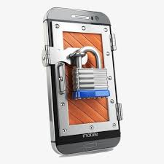
We share a lot of information on whatsapp so what assurance does Whatsapp give to upkeep the privacy:
First Whatsapp uses a unique end-to-end encryption.
WhatsApp end-to-end encryption ensures only you and the person you're communicating with can read what's sent, and nobody in between, not even WhatsApp.
Your messages are secured with locks, and only the recipient and you have the special keys needed to unlock and read your messages.
For added protection, every message you send has an unique lock and key.
All of this happens automatically: No need to turn on settings or set up special secret chats to secure your messages.

Slide 13
Summarising:
→ Whatsapp is programmed using the language Erlang.
→ Whatsapp works on the XMPP protocol.
→ It uses various keys and encryption to ensure privacy of messages.
Reference for keys:
1.Public Key Types:
• Identity Key Pair – A long-term Curve25519 key pair, generated at install time.
• Signed Pre Key – A medium-term Curve25519 key pair,generated at install time, signed by the Identity Key, and rotatedon a periodic timed basis.
• One-Time Pre Keys – A queue of Curve25519 key pairs for onetime use, generated at install time, and replenished as needed.
2.Session Key Types:
• Root Key – A 32-byte value that is used to create Chain Keys.
• Chain Key – A 32-byte value that is used to create MessageKeys.
• Message Key – An 80-byte value that is used to encrypt messagecontents. 32 bytes are used for an AES-256 key, 32 bytes for aHMAC-SHA256 key, and 16 bytes for an IV.

Slide 14
THE END

